Slide 1
Brands in Crisis

Slide 2
Overview
Types of brand crises
Examples of crisis response
  How to
  How not to
Managing a brand crisis
  Crisis avoidance
  Quick and sincere response
Real-time marketing

Slide 3
Types of Brand Crises
Product failure
Social responsibility deficit
Corporate malfeasance
Executive misbehavior
Spokesperson misbehavior

Slide 4
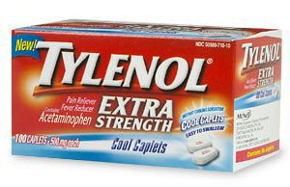
How To…
The “Gold Standard”: Tylenol

Slide 5
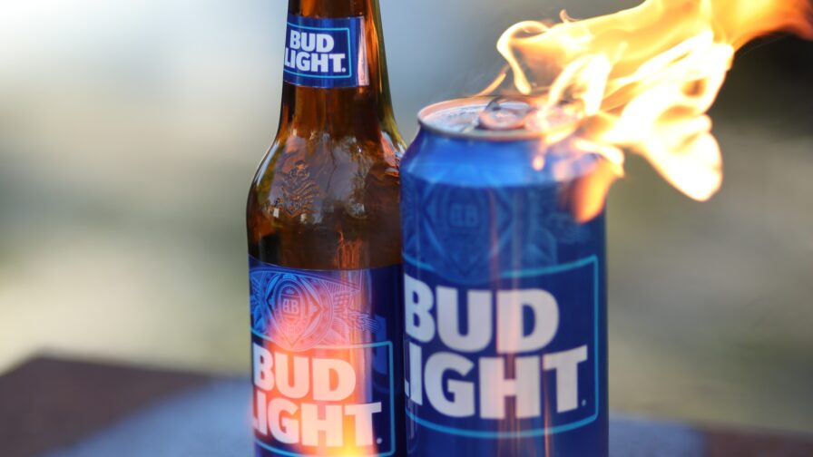
…And How Not To!

Slide 6
Managing a Brand Crisis
Work to avoid it in the first place!
Detect problem early and respond
Reduce adverse publicity
  Respond quickly
  Respond sincerely
Take on the critics when it’s phony

Slide 7
Crisis Avoidance
Pre-crisis planning
Create scenarios and responses
  Simulated crises
  Assess areas of vulnerability
  Multi-disciplinary crisis teams
  Designated and trained spokespeople
  Written plan

Slide 8
Quick Response
Necessitated by “24-7-365” news environment
Exacerbated by social media
Need to try to “nip it in the bud”
Counteract negative publicity
A source of positive brand associations (“voice of the firm”) rather than an uninterrupted wave of negative information

Slide 9
Sincere Response
“Bite the bullet”
Apologize, take responsibility, and promise to fix
Outline corrective steps being taken
Involvement of CEO
“America is all about ‘forgive and forget’; what America doesn’t like is someone who doesn’t own up.”

Slide 10
Real-Time Marketing
Newer approach to crisis management
Emphasizes immediacy of response
Facilitated by advance market intelligence
Content developed in advance (some never used)
“War room” with rapid response capability
“Bite-size” messages (e.g., Twitter)
Real time tracking of consumer sentiment

Slide 11
Conclusion
Has your brand/company suffered a “crisis” recently?
How was it handled?
What was the impact on brand equity?

Slide 12
End of Lecture

